Slide 1
Fantasy Place Name Generator
Jessica Fang

Slide 2
Abstract
The fantasy genre thrives off of its rich settings and the names of these made-up places are distinctively evocative of the genre. This program is a generative text model that will output believable suggestions for fantasy place names based on a dataset of 5952 names. It uses an LSTM neural network with one hidden layer.

Slide 3
Data
Fantasy place names were scraped from wikia article titles with an external program
Data taken from Malazan Book of the Fallen, Game of Thrones, The Stormlight Archive, Dungeons and Dragons, The Elder Scrolls, and The Witcher Series
About 2500 names scraped
The rest of the data was taken from a dataset of british place names
Total of about 6000 samples
Special characters (á, ê, etc.) were replaced
Names exceeding 13 characters or below 5 characters were removed

Slide 4
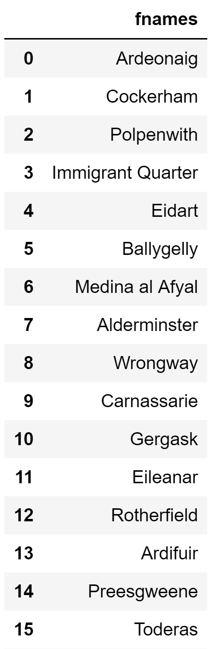
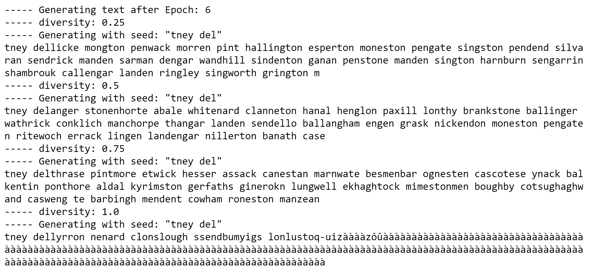
problems with special characters
allnames.head(15)

Slide 5
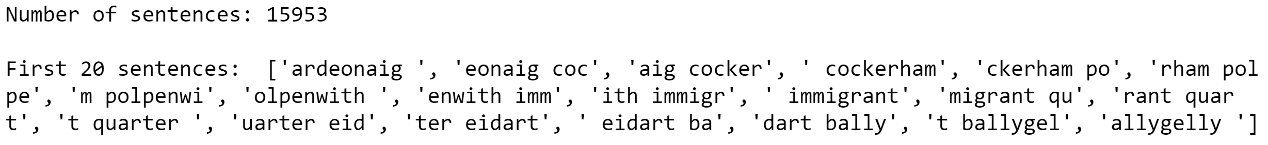
Method
Number of features for LSTM chosen using number of unique characters that occur in the dataset after all characters changed to lower case
Total of 28 unique characters (26 letters, hyphen, and space)
CSV concatenated and then parsed into strings of maxlength = 12 (arbitrary value) with a step size of 3
These strings are stored into array called sentences and used to train the LSTM

Slide 6
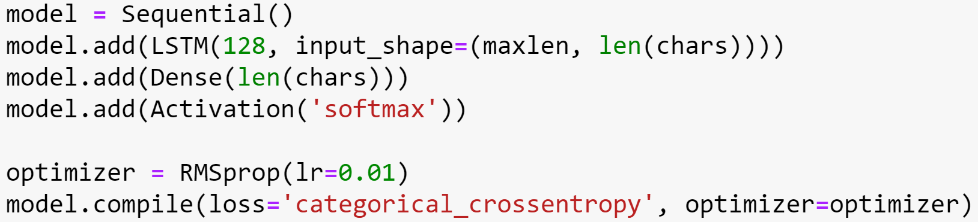
Creating the LSTM
1 Hidden layer, 1 dense output layer
Input shape: 10 (maxlength) by 28 (features/characters)
activation function: Softmax
Loss Function: Categorical cross-entropy
Temperatures: 0.25, 0.50, 0.75, 1.00

Slide 7
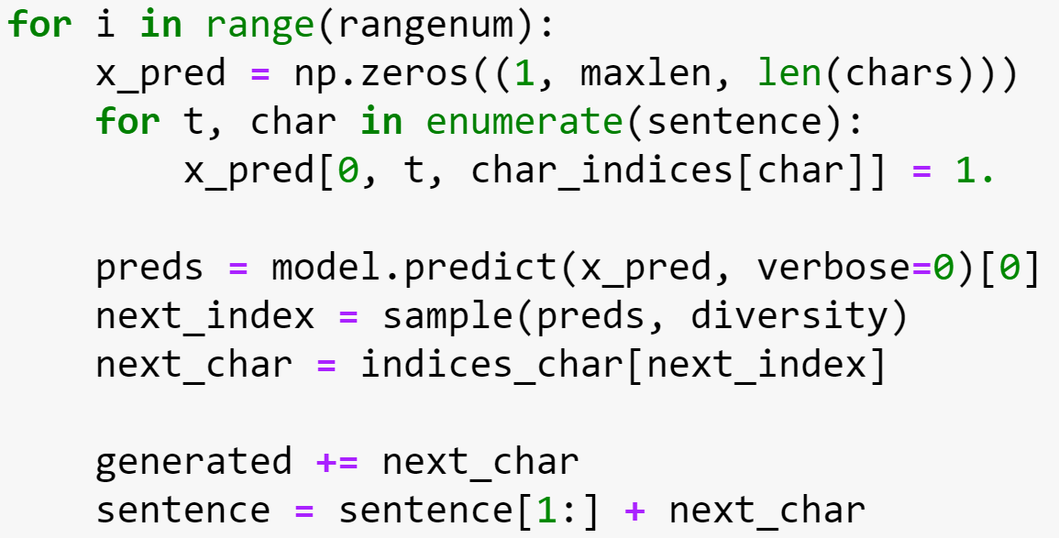
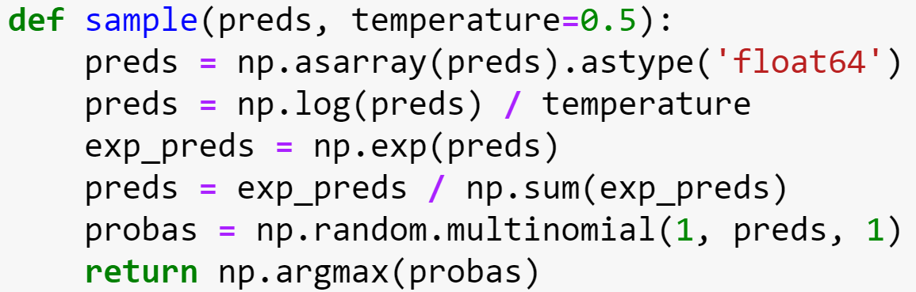
Training
Epoch size used was 16
For each epoch, a random sentence from the array is chosen to be the seed
model.predict()is called and returns array preds of predictions
Helper function sample() picks the next character based off a chosen temperature and an array of probabilities for each character
Loss function is evaluated and if loss improves, new weights are stored to weights.hdf5

Slide 8
Example Results
carraston
mither
gatholl
kilmeth
whirbor
portburg
shillang
stanes
waites
alinider
catheris
portham
ancarn
midle
mak
orstone
highney
dreen
shuryan
dovilling
mairinston

Slide 9
Conclusions and Possible Improvements
The generator works surprisingly well
This may be attributed to the inherent whimsy and arbitrariness of fantasy names, so exact language conventions did not need to be followed
To improve results further, another hidden layer could ne added to handle name length. The current neural network does not handle names with multiple words well
Additionally, using a pre-trained network such as word2vec to better handle names with real words in them (such as “King’s Landing”)
More testing could be done to determine the optimal maxlength and epoch size

Slide 10
Sources
Program for scraping article names from Wikia adapted from this scraper
Code for the Fantasy Place Generator created following this tutorial

